Slide 1
New Employment Contract Administration team
and the future departmental alignment of ECA, Consultancy, and Payroll teams

Slide 2
What is ECA?
The ECA is a restructure within the HR Division
Consolidates into one team all employment life cycle processes
A One stop shop for contracts, RTW, DBS and CoS
Consists of 5 teams covering three schools and PS (SLMS consists of two teams)
Required to build closer working relationships with HoDs, DA’s and staffing officers
Delivering to service standards within mapped processes, with clear user responsibilities, working to published deadlines & qualitative outputs
Responsible for reviewing and changing processes which better enable the use for customers and simplifies the process
Delivering a step change in customer service

Slide 3
What’s changing?
HR Operations and HR Consultancy Administration team will be no more
Focus on standards, quality, customer service
One stop shop with named go to people
Alignment of work splits across ECA, HRC and Payroll teams
Accountability through a responsibility matrix within each process
Published processes
Business process review over the next year

Slide 4
When is it changing?
Recruiting of staff commenced
Communications and impact of change throughout November
ECA to be launched 2nd December 2013
Transition period of circa 4 months to embed processes and complete the full handover from HRC to ECA
Dec 2013 – July 2014 - Begin review of processes including actions in schools – consult with users on effective change and simplification – simplify contracts
Build closer relationships with users through a CRM model to enable understanding of your business, pressures and timelines
Publishing of performance
Notes:
4

Slide 5
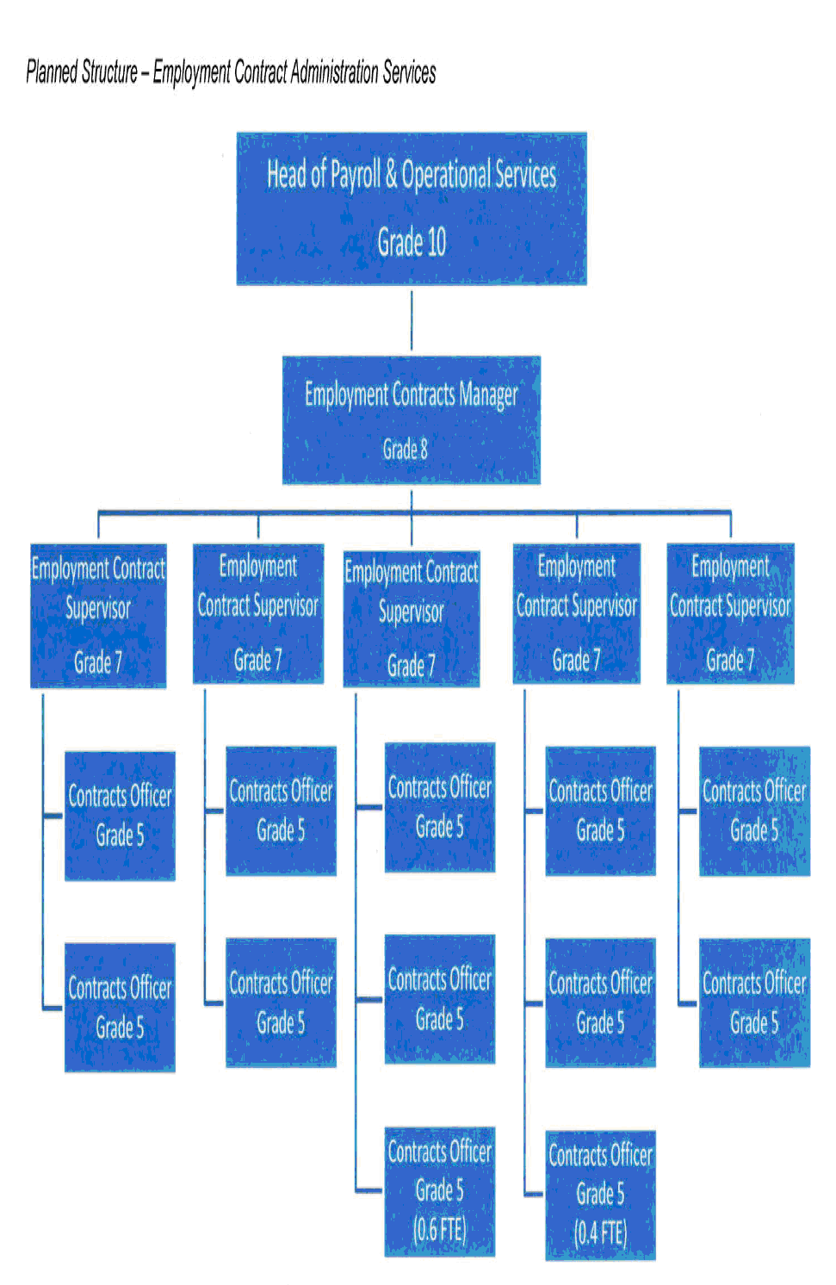
What will it look like?
Notes:
5

